Slide 1
LEAD SCORING CASE STUDY

Slide 2
Problem Statement
An education company named X Education sells online courses to industry professionals
On any given day, many professionals who are interested in the courses land on their website and browse for courses
Any individual who shows interest in X Education’s online courses become a lead for the company
Goal of this case study is to identify if a particular lead will get converted as a customer in future.
By identifying such potential customers, company wants to approach them with some good offers and contents.

Slide 3
Analysis Approach
Data Exploration
  Reading data
  Analyzing data size, data types etc.
Data Quality Checks
  Duplication checks
  Missing values analysis
  Outlier analysis
Data Cleansing
  Missing value imputation
  Outliers treatment

Slide 4
Analysis Approach...
Data Preparation
  Binary and one-hot encoding
  Categorization of low count data to Others
  Dummy encoding
  Train-Test Split
  Scaling using min max scalar
  Drop correlated columns

Slide 5
Analysis Approach...
Model building
  Feature selection using RFE
  Validate correlation-ship between RFE selected variables
  Assess model using StatsModel
    Feature elimination using p-value and VIF score
  Prediction on train set
    Validate predicted values using different metrics such as sensitivity, specificity, accuracy etc.
    Finding optimal cut-off point
  Predictions on the test set
    Validate similar metrics on test predicted values

Slide 6
Data Exploration
Leads data contained around 9000+ records with 37 columns
Many columns are with binary(Yes/No) answers
Converted column shows whether lead was actually converted or not, i.e. lead is converted to active customer or not.

Slide 7
Data Quality Checks
Duplication checks
  ProspectID column is used to label individual customer. There are no duplicates found in this column.
Missing Value Checks
  Select value in any column is because customer did not select any option from dropdowns available on application form. So, this value can be treated as null as we are not sure about customer’s point of view

Slide 8
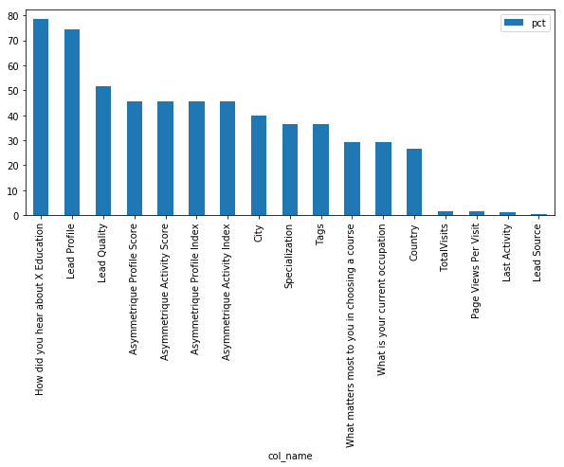
Data Quality Checks
Missing Value plot
Following plot shows missing values % in each column.

Slide 9
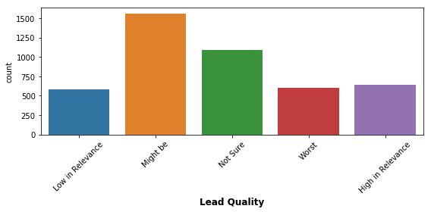
Data Cleansing
Missing value imputation
Here, we have checked value count distribution for each variable. Using this, we can decide if a particular value can be imputed in place of NULLs.
An example in explained below.
Adjacent plot is the Lead Quality column value count distribution.
Lead Quality column indicates the quality of lead based on the data and intuition the employee who has been assigned to the lead. So, We can impute null values in Lead Quality column with Not Sure value as we do not know quality of the lead. Also, this is possibly not a drop down column in the form. This column's data is derived on the intuition of other data points.

Slide 10
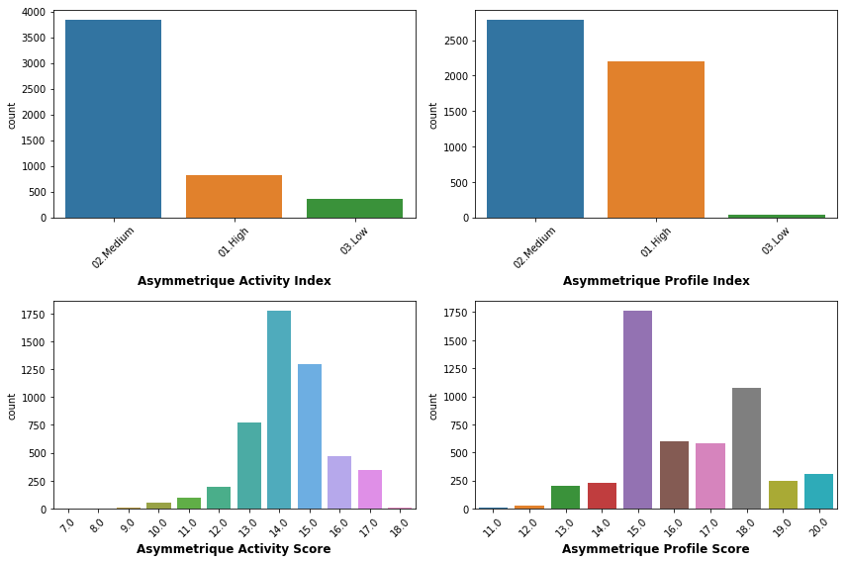
Data Cleansing
Missing value imputation
We have also analyzed the count distribution of following variables
  Asymmetrique Activity Index
  Asymmetrique Profile Index
  Asymmetrique Activity Score
  Asymmetrique Profile Score
An index and score assigned to each customer based on their activity and their profile. Also, there is no specific pattern how scores and indexes are calculated. So, It will be highly difficult to predict value to be imputed in null records. So, it is better to drop columns these columns

Slide 11
Data Cleansing
Missing value imputation
Using similar approached, we imputed country as India in NULL country values, as customer visiting website are mostly Indian customers. So, we can follow this intuition
NULL values in What matters most to you in choosing a course is imputed with Better Career Prospects which constitutes 99% of available values in this column
Tags and City column is dropped as there is a lot of variance in both of these columns. So, it is difficult to impute any value in place of NULLs
Also, we have dropped rows with more than 30% missing data

Slide 12
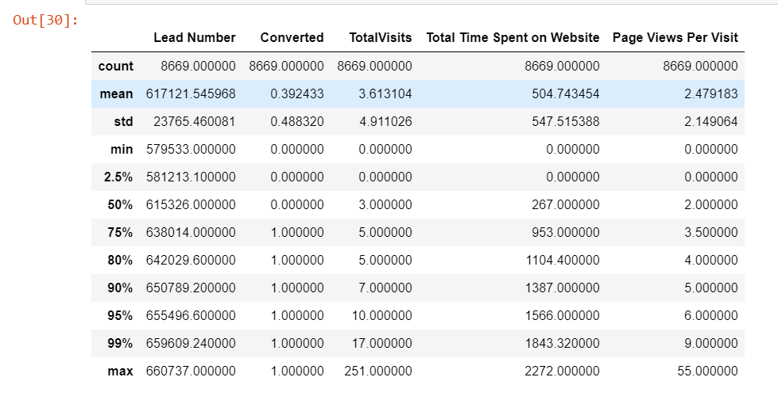
Data Cleansing
Outlier treatment
As per statistical analysis of numerical column in dataset, we found outliers in TotalVisits and Page Views Per Visit columns.

Slide 13
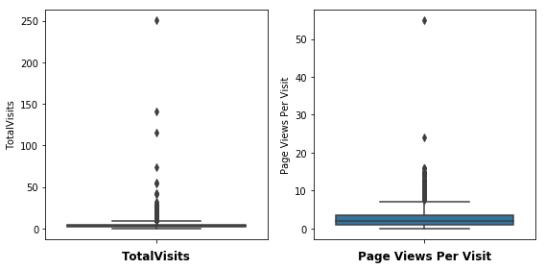
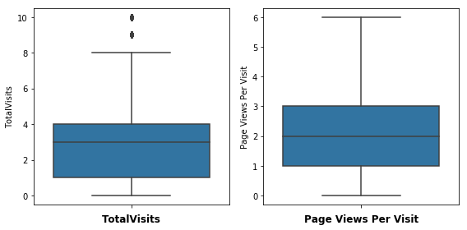
Data Cleansing
Outlier treatment
We removed outliers above 95th percentiles
Above plots shows, distribution of both the variables, before and after removing outliers

Slide 14
Data Preparation
In this section, we did binary encoding for following columns
  'Do Not Email'
  'Do Not Call'
  'Search'
  'Newspaper'
  'Digital Advertisement'
  'Through Recommendations'
  'A free copy of Mastering The Interview'
Create dummy variables using remaining variables

Slide 15
Data Preparation
Next step is train-test split
After train-test split, train variables are scaled to confine the values between 0 and 1 using MinMaxScaler()
Same MinMaxScaler instance to be used to scale test dataset as well
Check correlation-ship between new dummy variables created to check multicollinearity
Drop highly correlated variables

Slide 16
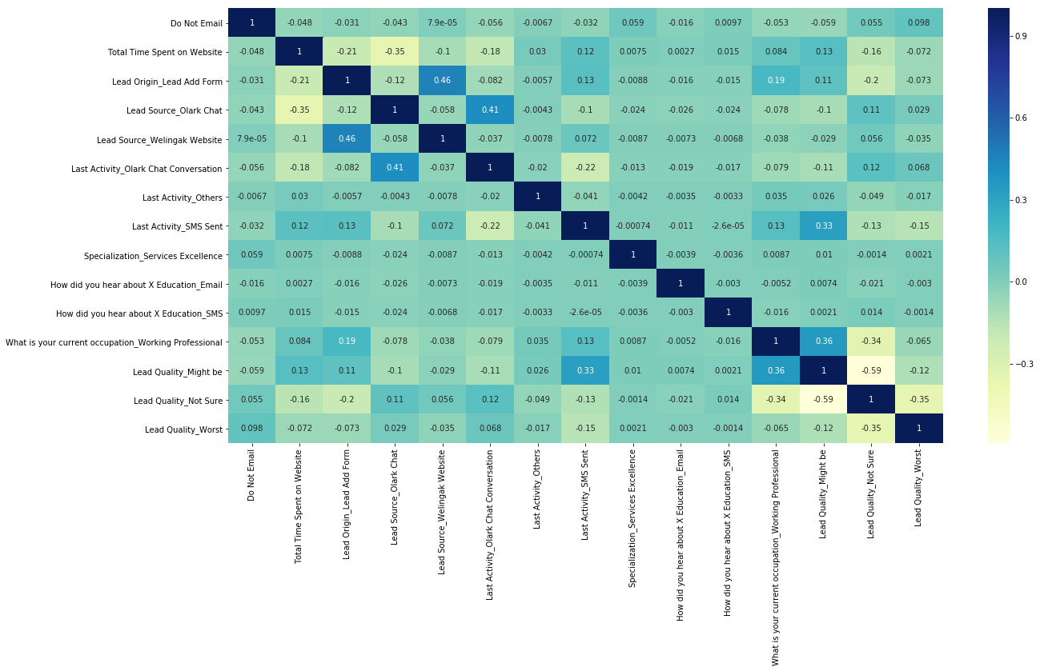
Model Building
Feature selection using RFE
Feature selection using RFE
  Selected 15 top variables using RFE
  Check multi-collinearity between RFE selected variables
  There is no high multi-collinearity between RFE selected variables. So, no need to drop any variables

Slide 17
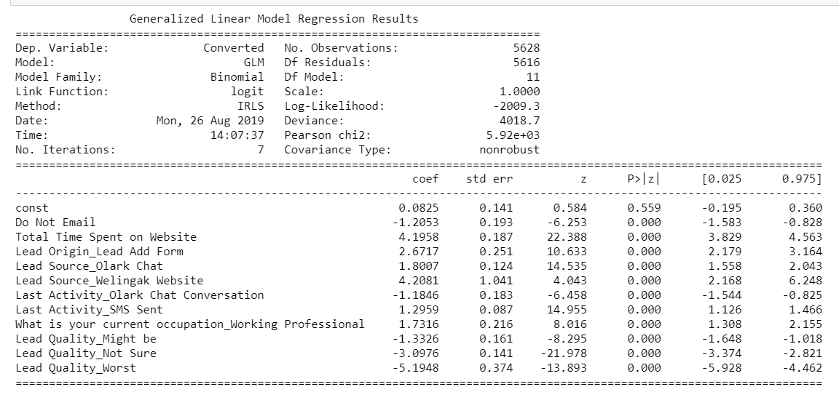
Model Building
Assessing the model with StatsModels
Following statistical summary is given by final model derived after iterations. Variables are dropped and model is re-created for validating results. Final model shows that p-value of all the independent variables is close to 0 and thus are significant.

Slide 18
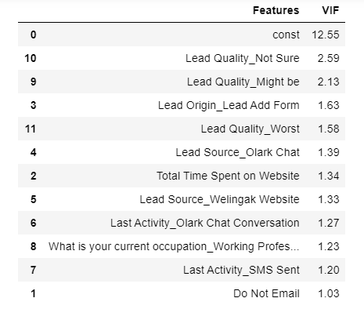
Model Building
Assessing the model with StatsModels
We have also validated VIF score of all the features to identify any multi-collinearity between chosen independent variables.
Adjacent screenshot shows VIF score for all the features given by final model
We can see that VIF score for all the features is below 5. Thus, there is no collinearity issue between selected features.

Slide 19

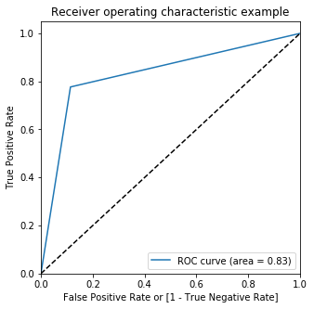
Prediction on train data set and Model Validation
Conversion probability is calculated by model with around 84% accuracy in train data set
ROC curve:
Area under the curve is 0.83.
This indicates that model has good measure of separability

Slide 20
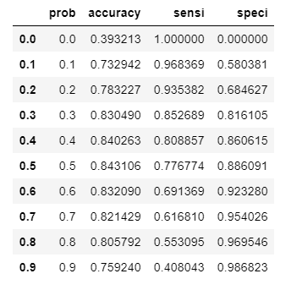
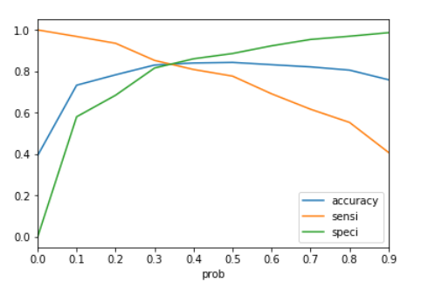
Model Validation...
We have also calculated accuracy,Sensitivity and Specificity measures for different cut-off points as mentioned in below table. As per the below table and plot, 0.3 seems to be the optimal cut-off point.

Slide 21
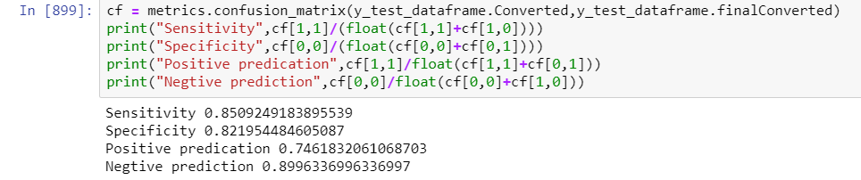
Predictions On The Test Data set
Following are the metrics calculated for test dataset predictions
  Accuracy Score
  Sensitivity & Specificity
All the above metrics have values very close to what we got with train data set So, model's behavior is consistent and it can be considered to be a good model

Slide 22
Observations & Recommendations
As per the model summary mentioned, we can say that following are few variables which we can use to optimize our conversion rate.
Lead Source_Welingak Website - Highest positive standardized coefficient value
Total Time Spent on Website - 2nd Highest standardized positive coefficient value
Lead Origin_Lead Add Form - 3rd highest standardized positive coefficient value
Lead Quality_Worst - Highest standardized negative coefficient value
Marketing team needs to concentrate on these variables to optimize our conversion rate.

